Slide 1

Advanced Concepts of Modeling in AI
SECTION - B
Unit 2

Slide 2

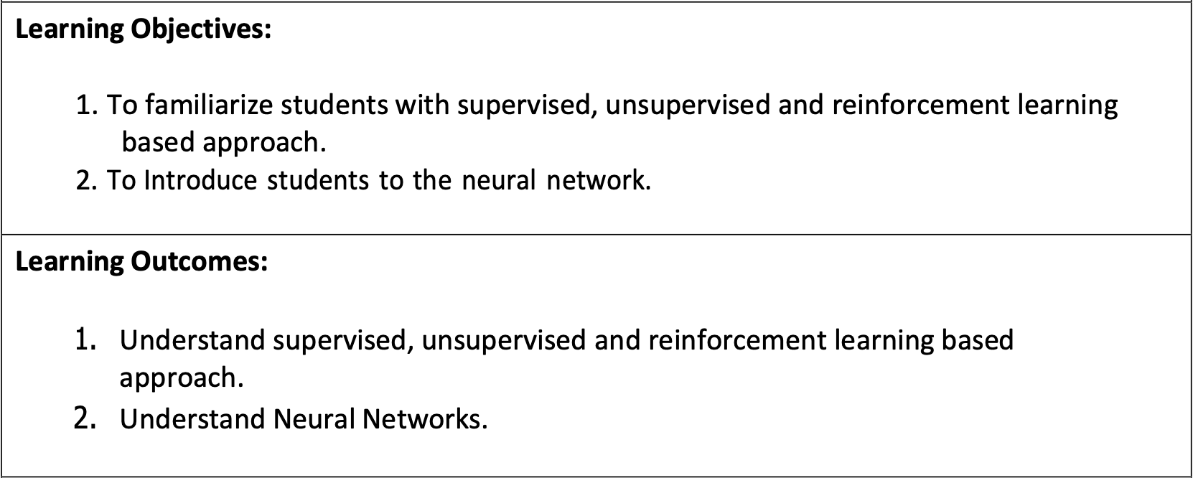

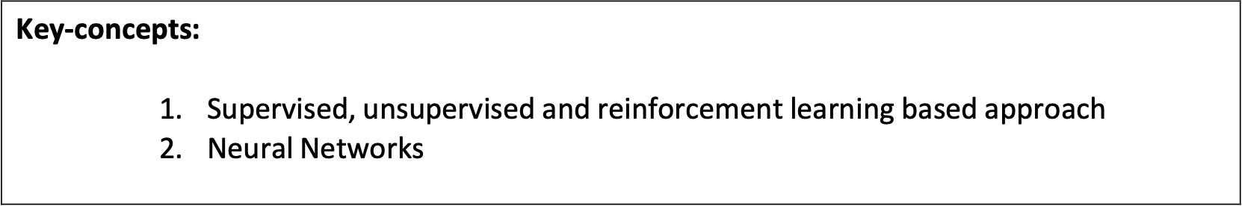

Slide 3

To build an AI based project, we need to work around Artificially Intelligent models or algorithms. This could be done either by designing your own model or by using the pre-existing AI models. Before jumping into modelling let us clarify the definition of Artificial Intelligence (AI), Machine Learning (ML) and Deep Learning (DL).
2.1 Revisiting AI, ML, DL

Slide 4
Differentiate between AI, ML and DL
AI
ML
DL
Artificial Intelligence, or AI for short, refers to any technique that enables computers to mimic human intelligence. An artificially intelligent machine works on algorithms and data fed to it and gives the desired output.
Machine Learning (ML) helps computers learn and get better at tasks over time, just like how students learn from practice. The computer uses new data to improve its answers and also learns from its mistakes so it can do better next time.
Deep Learning, or DL for short, enables software to train itself to perform tasks with vast amounts of data. Since the system has got huge set of data, it is able to train itself with the help of multiple machine learning algorithms working altogether to perform a specific task.

Slide 5
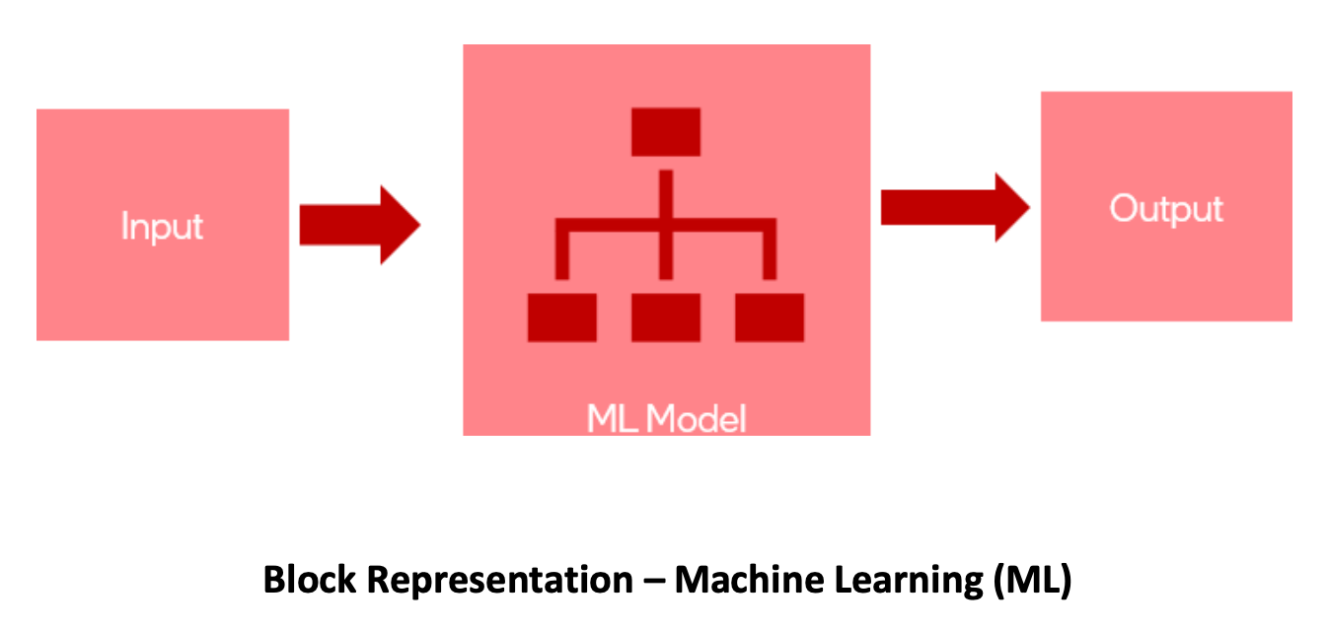
Machine Learning (ML)
Machine Learning (ML) is a way for computers to learn from data and improve their performance without being told exactly what to do at every step. Instead of following only fixed instructions, the computer looks for patterns in data, uses them to make predictions or decisions, and gets better over time by learning from new data and its mistakes.
This is just a broad representation of how a machine learning model works. Input (past or historical data) is given to the ML model and the model generates output by learning from the input data.

Slide 6
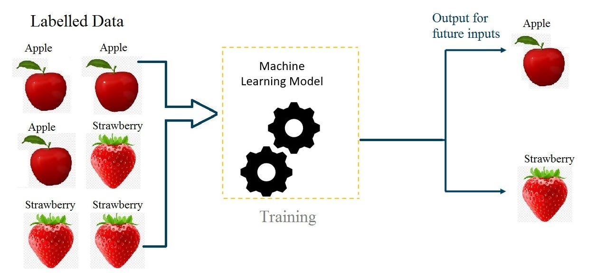
How does it work?
Example shows labelled images (every image is tagged either as apple or strawberry) are given as input to the ML model. ML model learns from the input data to classify between apples and strawberries and predicts the correct output as shown.

Slide 7
Example - ML
Common Machine Learning Examples and use Cases:
Product/Streaming Recommendations: Algorithms (like on Spotify or Netflix) analyze browsing/listening history to suggest new content.
Voice Assistants: Systems like Siri, Alexa, and Google Assistant use natural language processing (NLP) to understand commands and speech.
Fraud Detection: Banks automatically flag suspicious transactions using pattern recognition.
Email Filters: Classifying incoming emails as spam or legitimate, learning from user behavior.
Transportation/Navigation: Google Maps analyzes traffic to determine the fastest routes.
Healthcare Diagnostics: Analyzing X-rays or genetic data to detect diseases earlier than traditional methods.
Predictive Text/Autocorrect: Smart keyboards learn typing patterns to suggest words.
Chatbots: AI-powered customer service bots handling support queries 24/7.

